Slide 1
ParkEz Application
Team 2 : Tom Cookson, Tom Alex, Shubham Mittal, Chetan, Krunal Bhavsar, Suruchi, Srija, Ruchi Sharma, Swayambhu dhuri

Slide 2
TABLE OF CONTENTS
01
02
03
04
GitHub URL
Repository Structure
Build & Deployment Procedures
Source Code Excerpt

Slide 3
GitHub URL
https://github.com/swayambhu/parkEz

Slide 4
02
Repository Structure

Slide 5
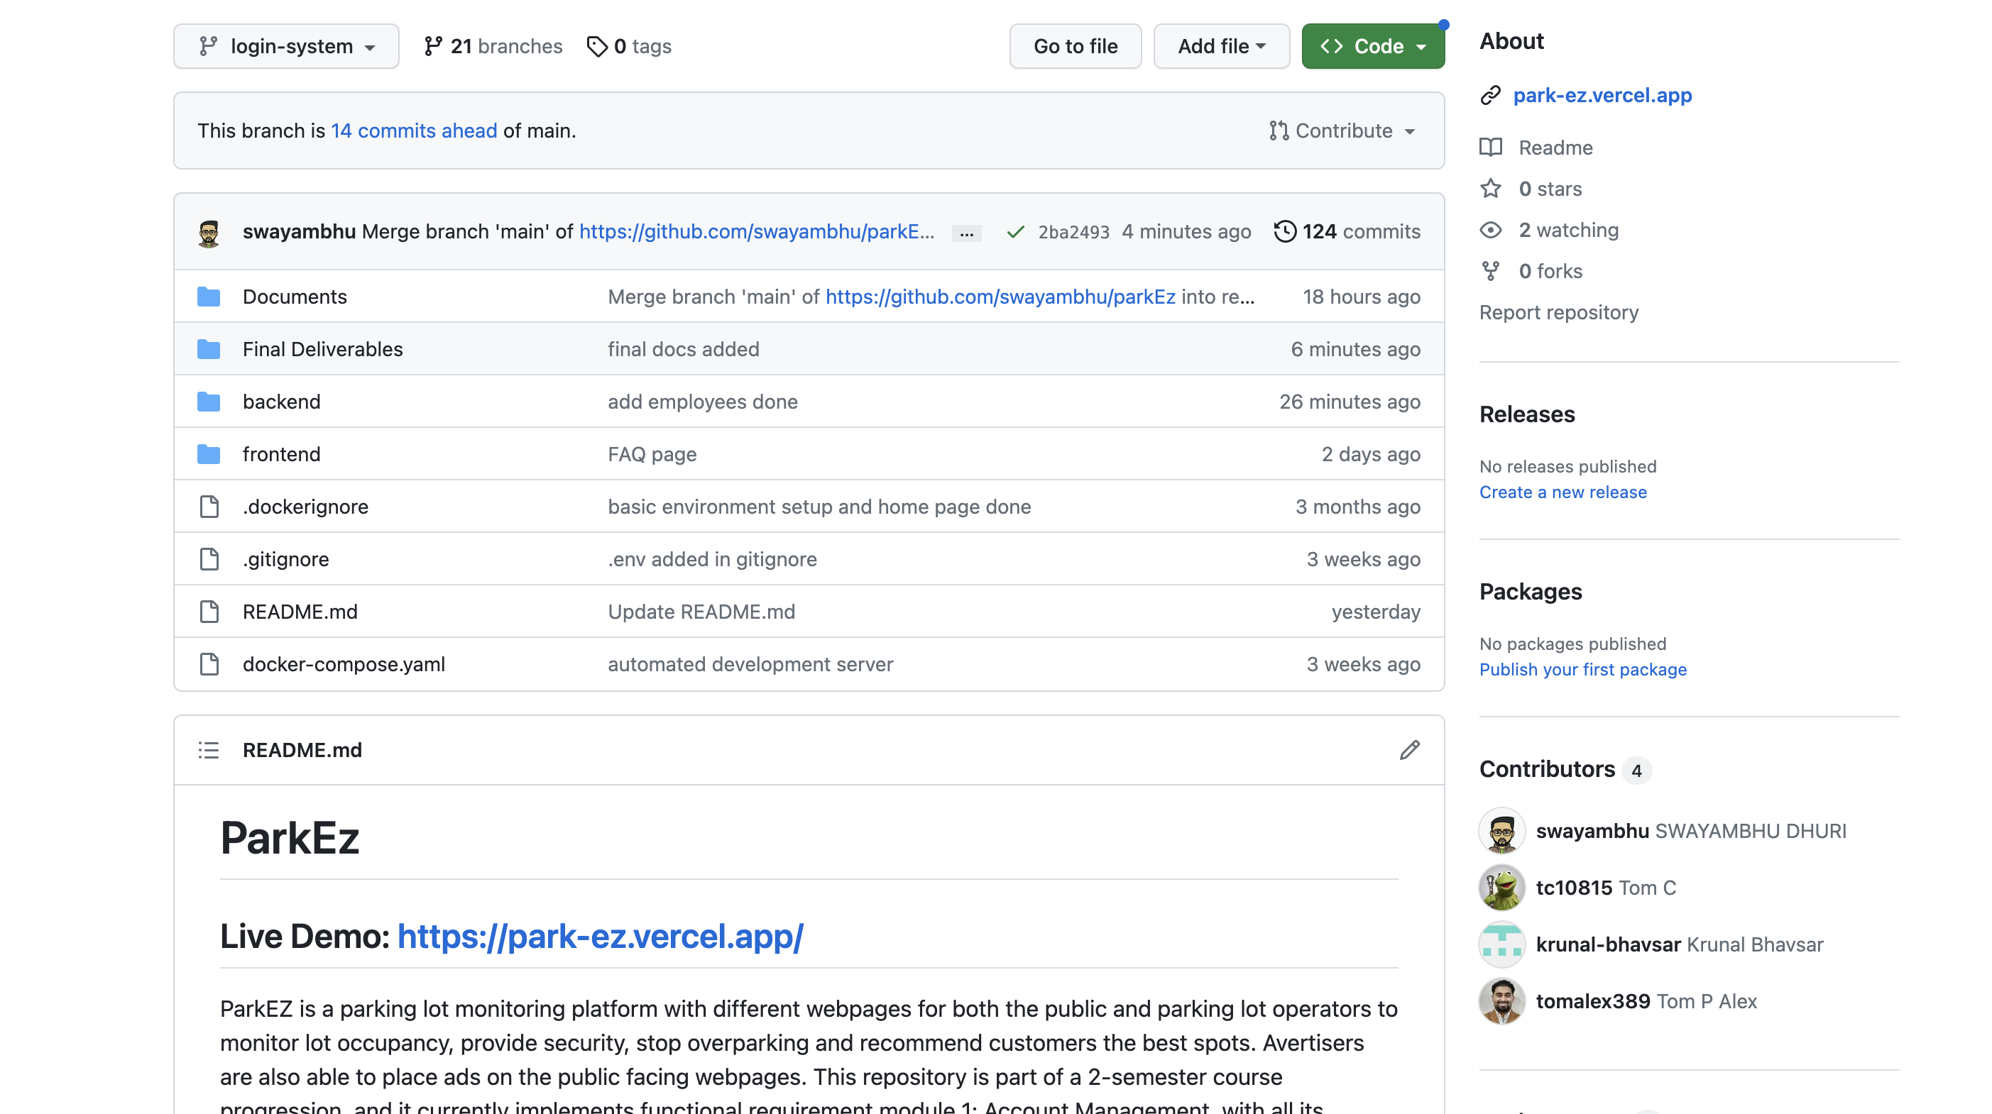

Slide 6
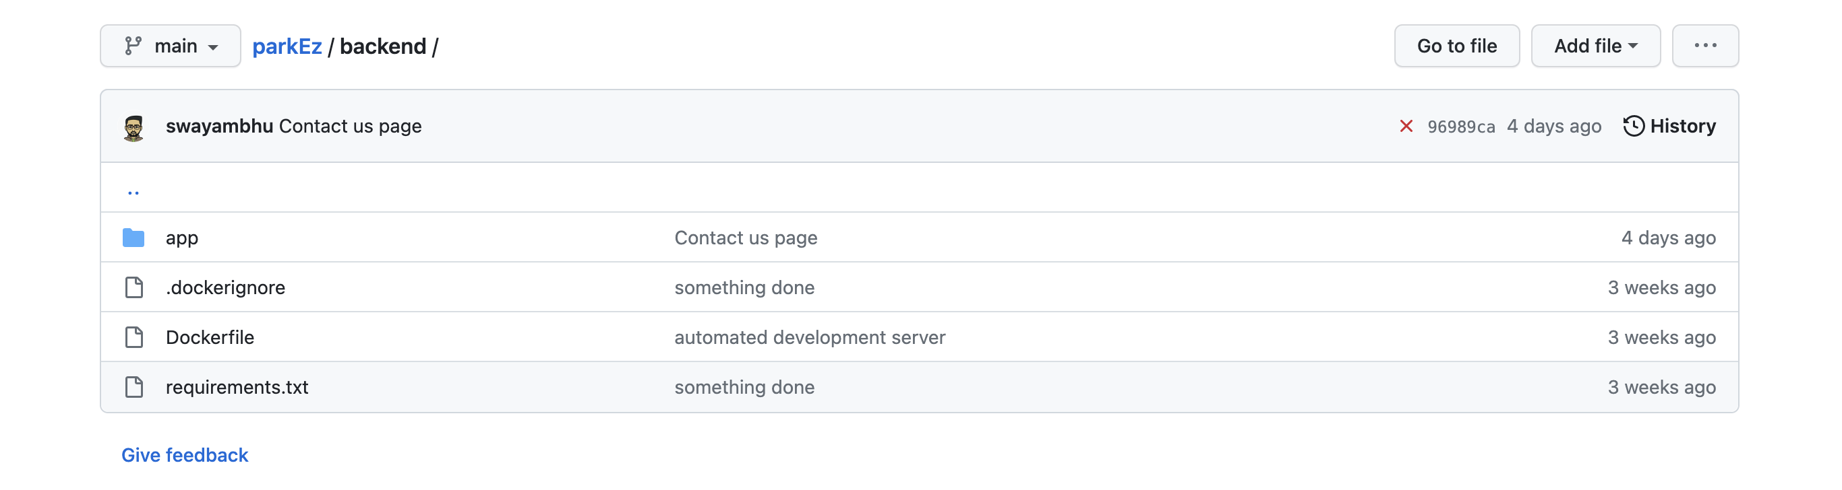
Repository Structure (Backend)

Slide 7
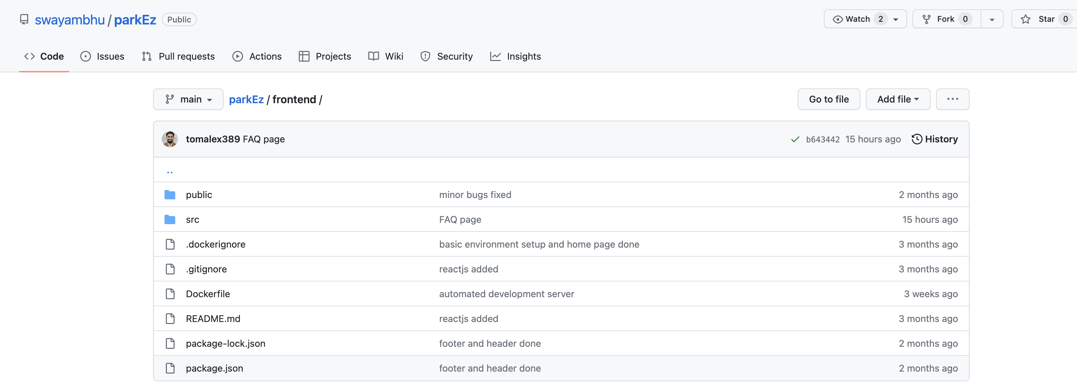
Repository Structure (Frontend)

Slide 8
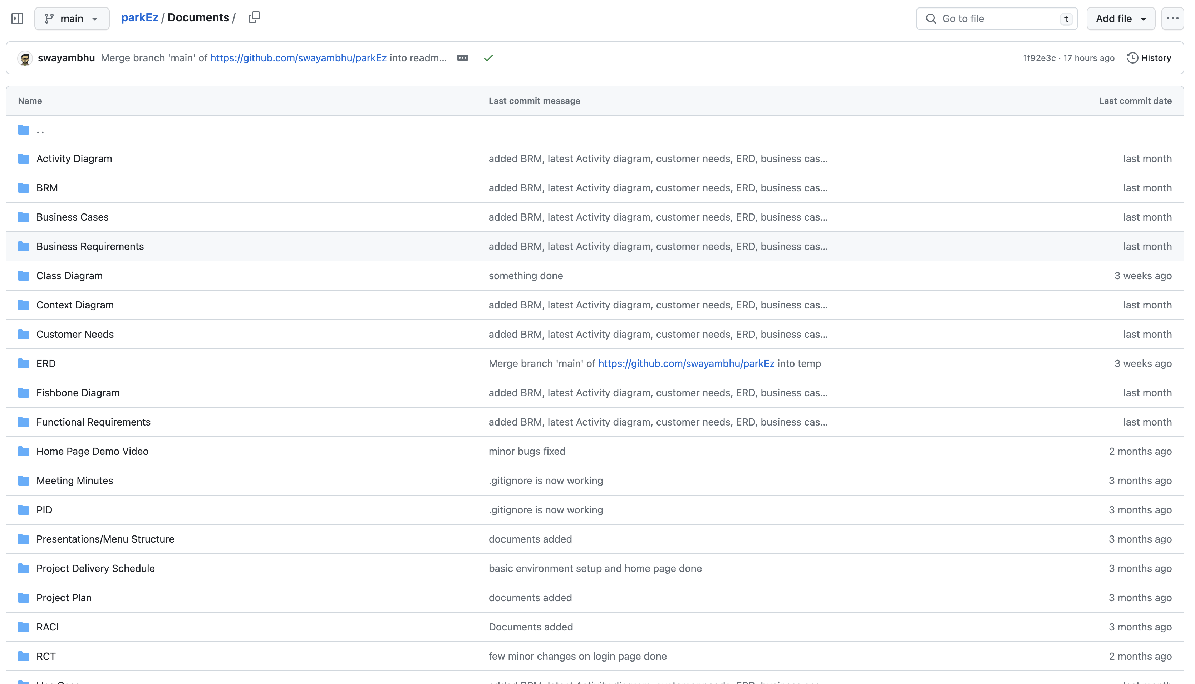
Repository Structure (Final Deliverables)

Slide 9
03
Build & Deployment Procedures

Slide 10
Pre-requisites
Docker
Initializing docker-compose up.

Slide 11

Installation Steps
In the project directory, you can run:
npm start
Runs the app in the development mode. Open http://localhost:3000 to view it in your browser. The page will reload when you make changes. You may also see any lint errors in the console.

Slide 12
Installation Steps
In the project directory, you can run:
npm test
Launches the test runner in the interactive watch mode. See the section about running tests for more information.

Slide 13
Installation Steps
In the project directory, you can run:
npm run build
Builds the app for production to the build folder. It correctly bundles React in production mode and optimizes the build for the best performance. The build is minified and the filenames include the hashes. Your app is ready to be deployed! See the section about deployment for more information.

Slide 14
Installation Steps
In the project directory, you can run:
npm run eject
Note: this is a one-way operation. Once you eject, you can't go back! If you aren't satisfied with the build tool and configuration choices, you can eject at any time. This command will remove the single build dependency from your project. Instead, it will copy all the configuration files and the transitive dependencies (webpack, Babel, ESLint, etc) right into your project so you have full control over them. All of the commands except eject will still work, but they will point to the copied scripts so you can tweak them. At this point you're on your own. You don't have to ever use eject. The curated feature set is suitable for small and middle deployments, and you shouldn't feel obligated to use this feature. However we understand that this tool wouldn't be useful if you couldn't customize it when you are ready for it.

Slide 15
04
Source Code Excerpt

Slide 16
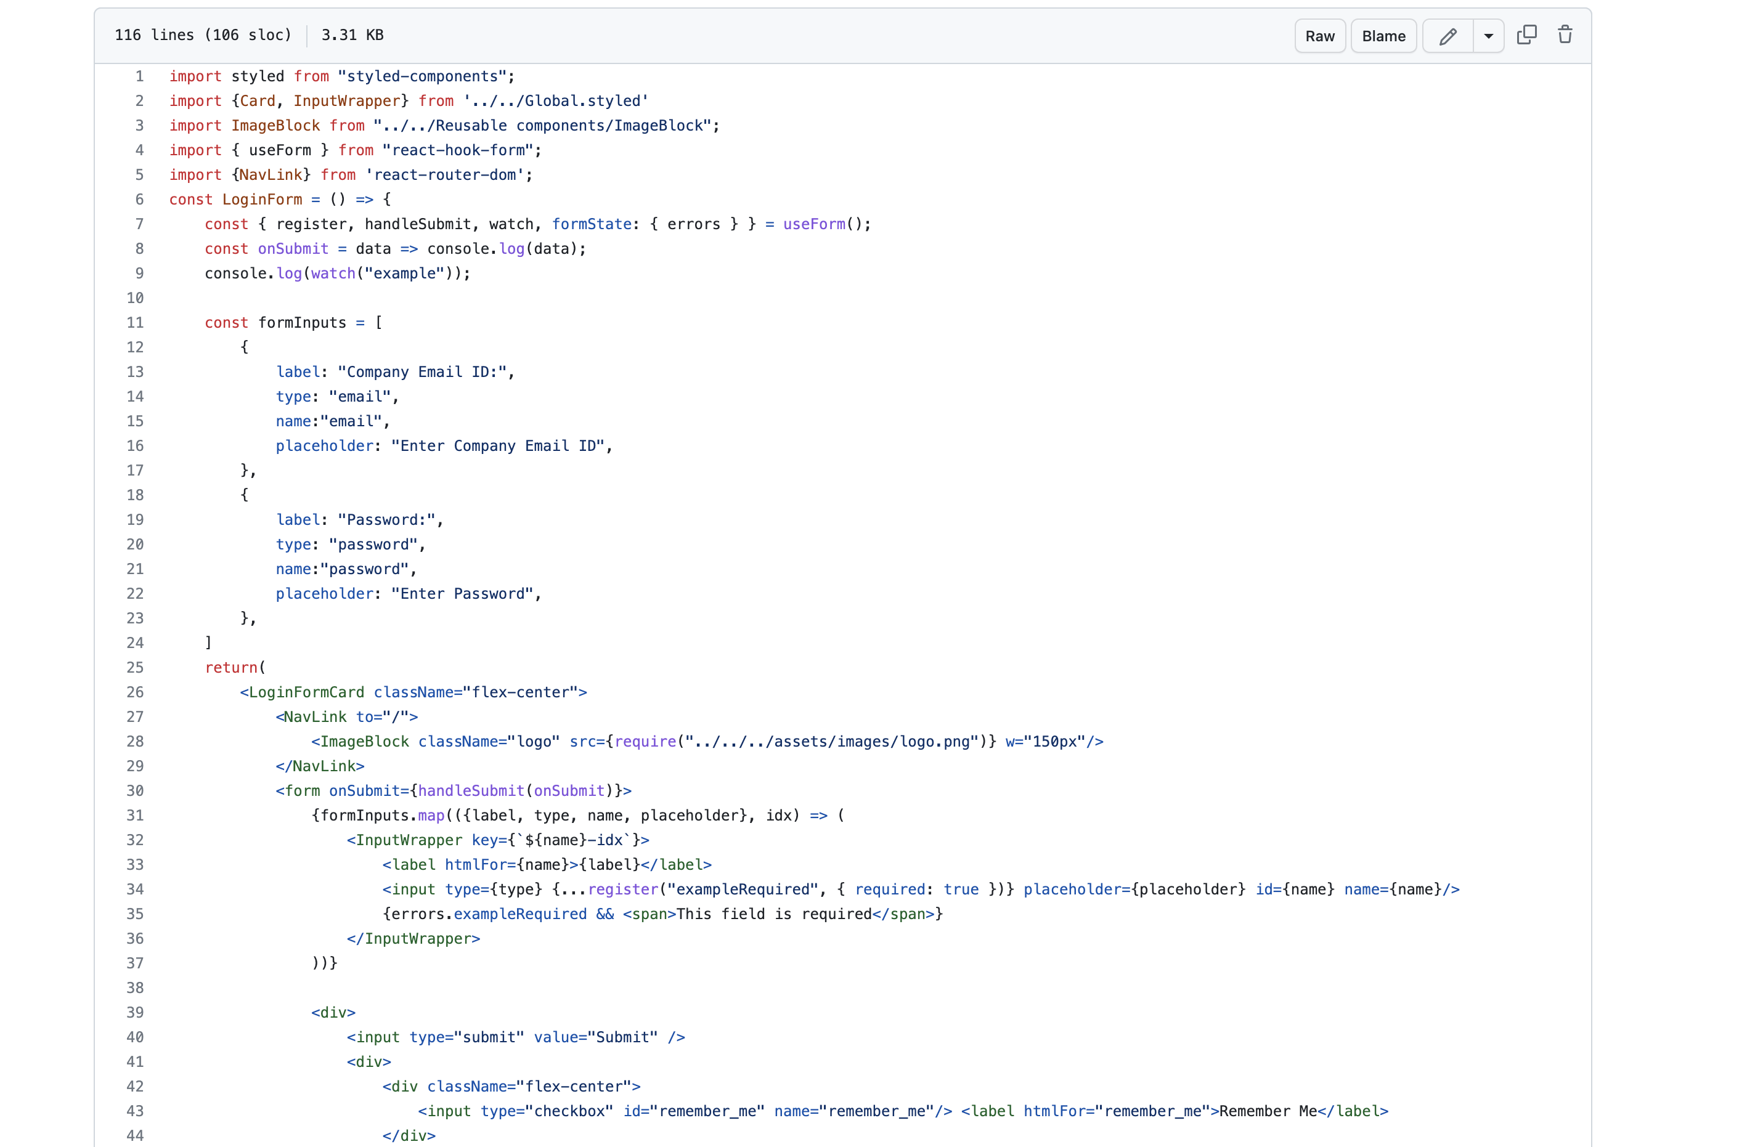
Feature-Log in

Slide 17
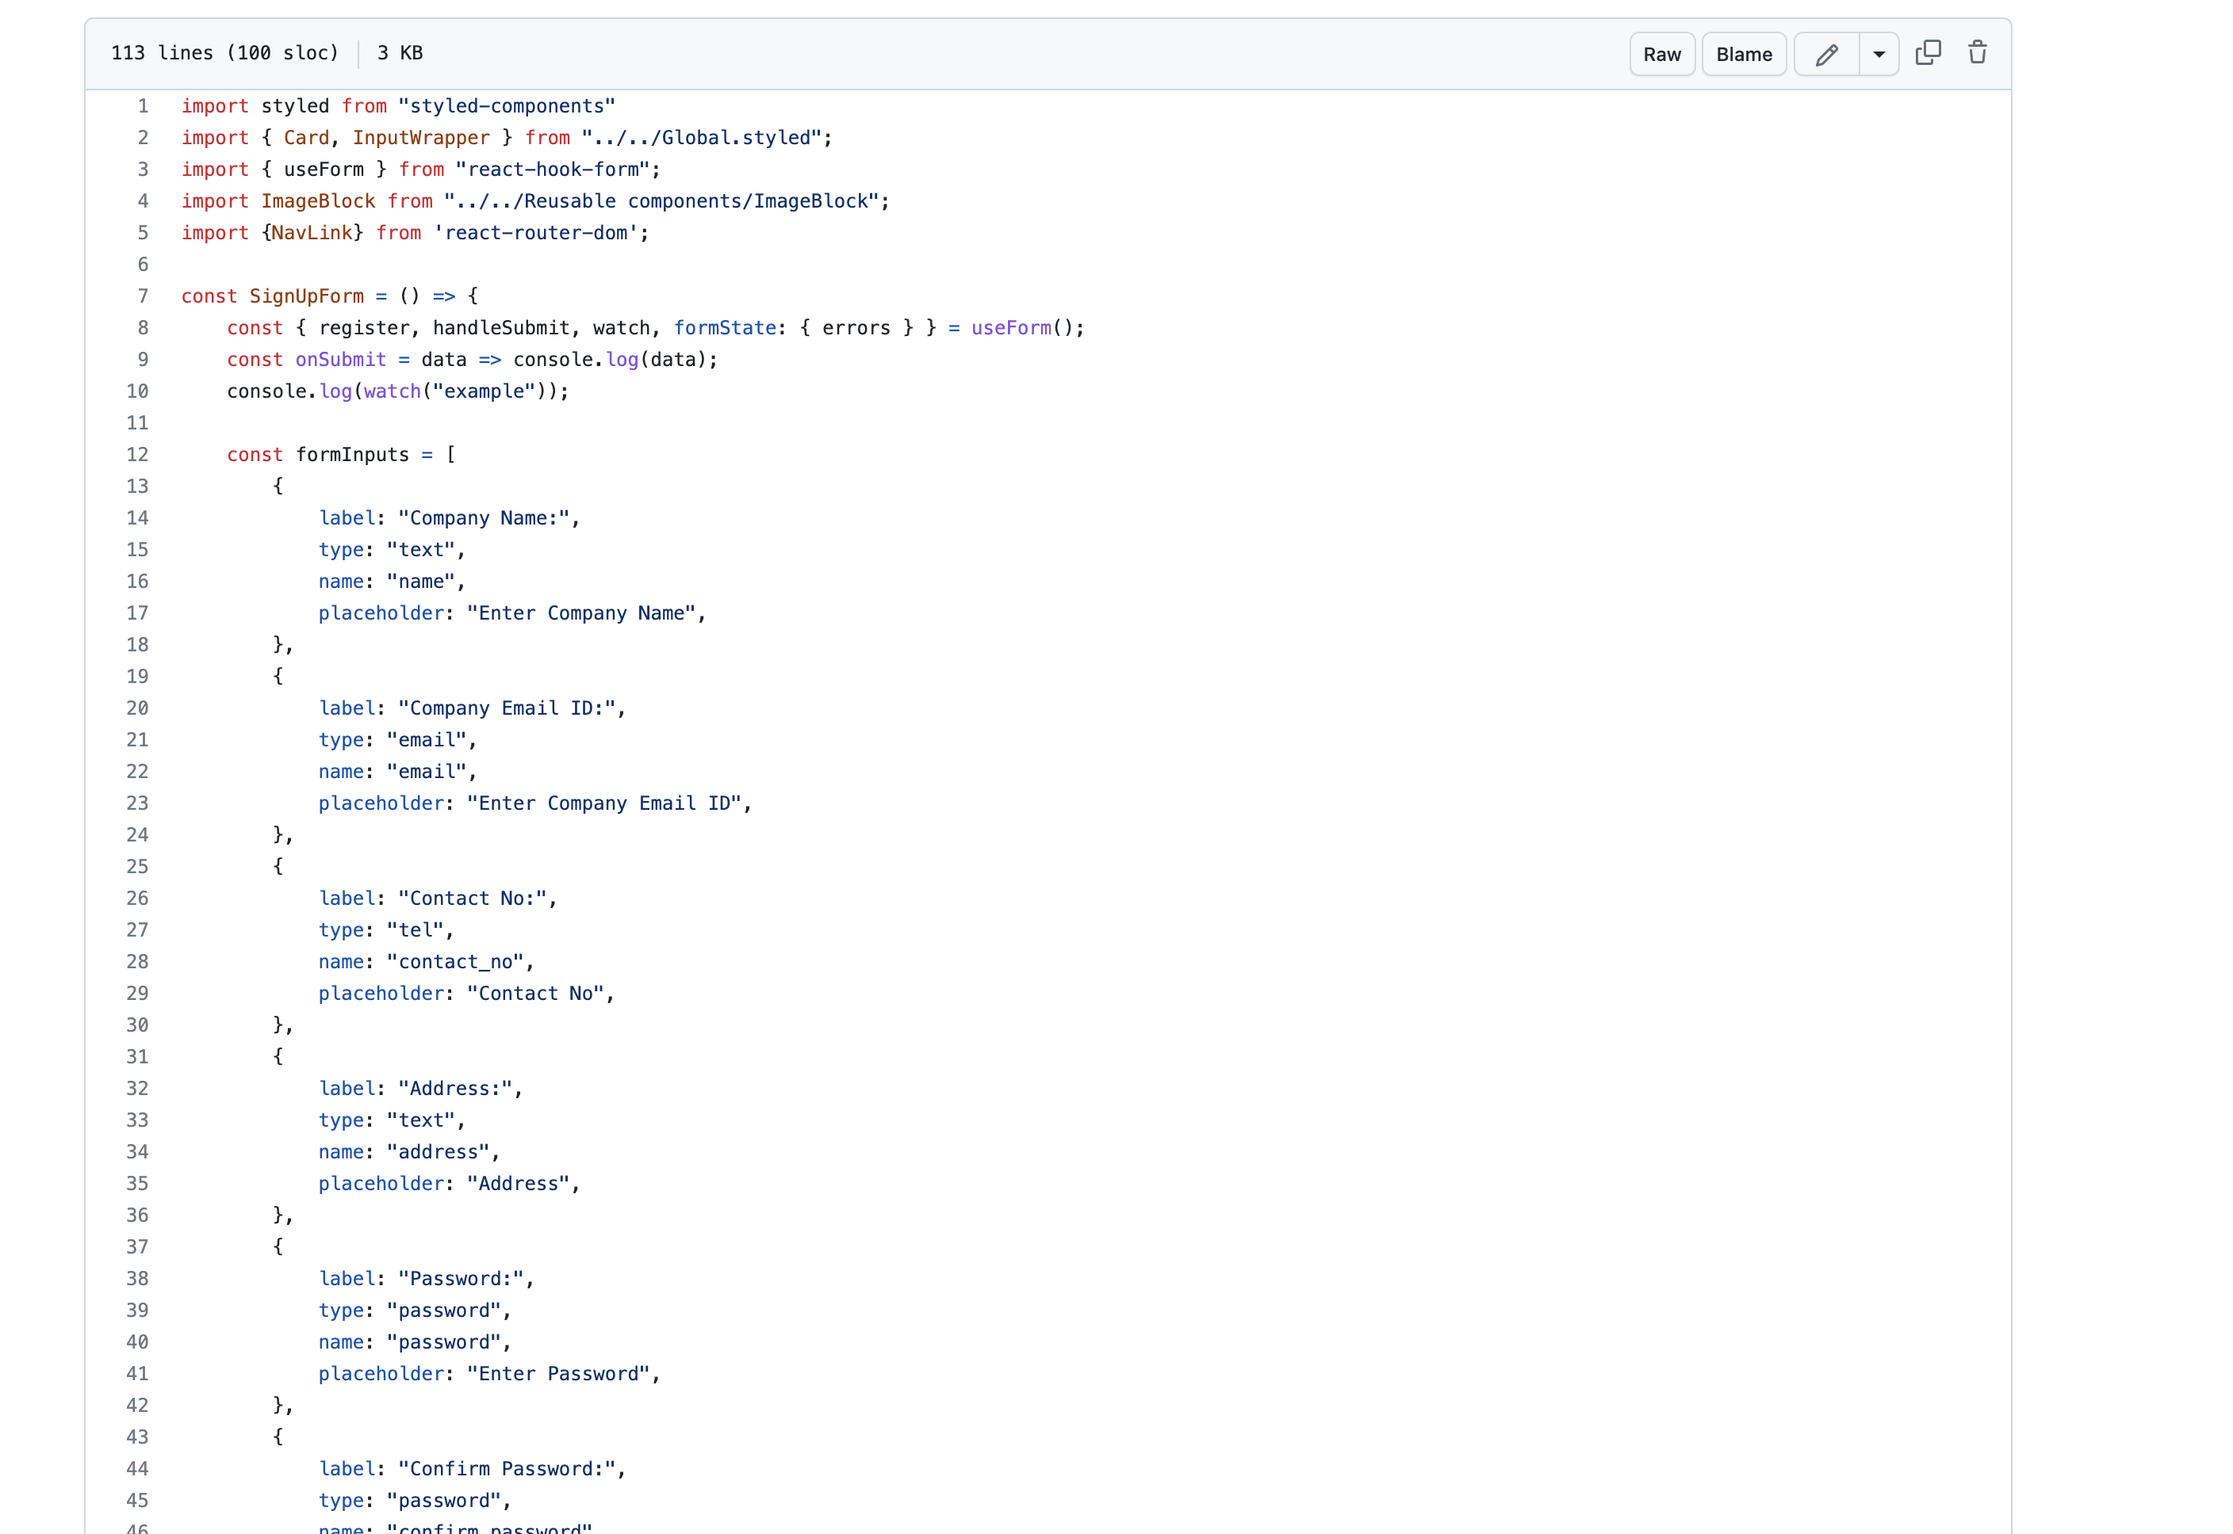
Feature- Sign up

Slide 18
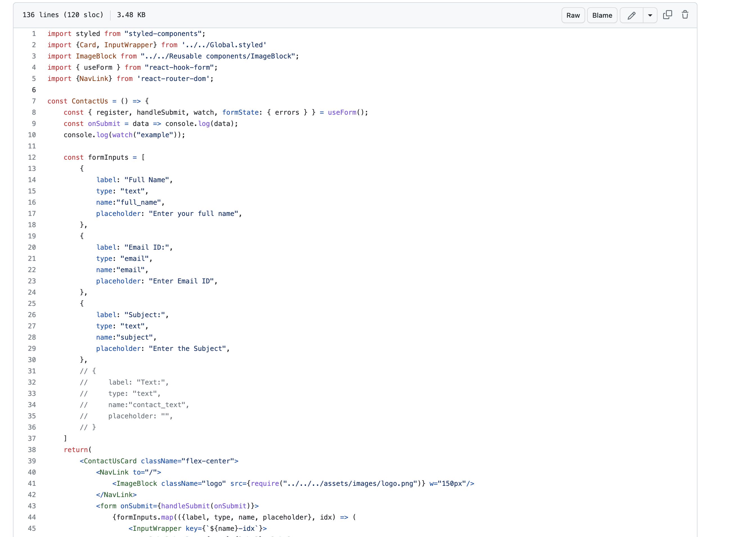
Feature- Contact us

Slide 19
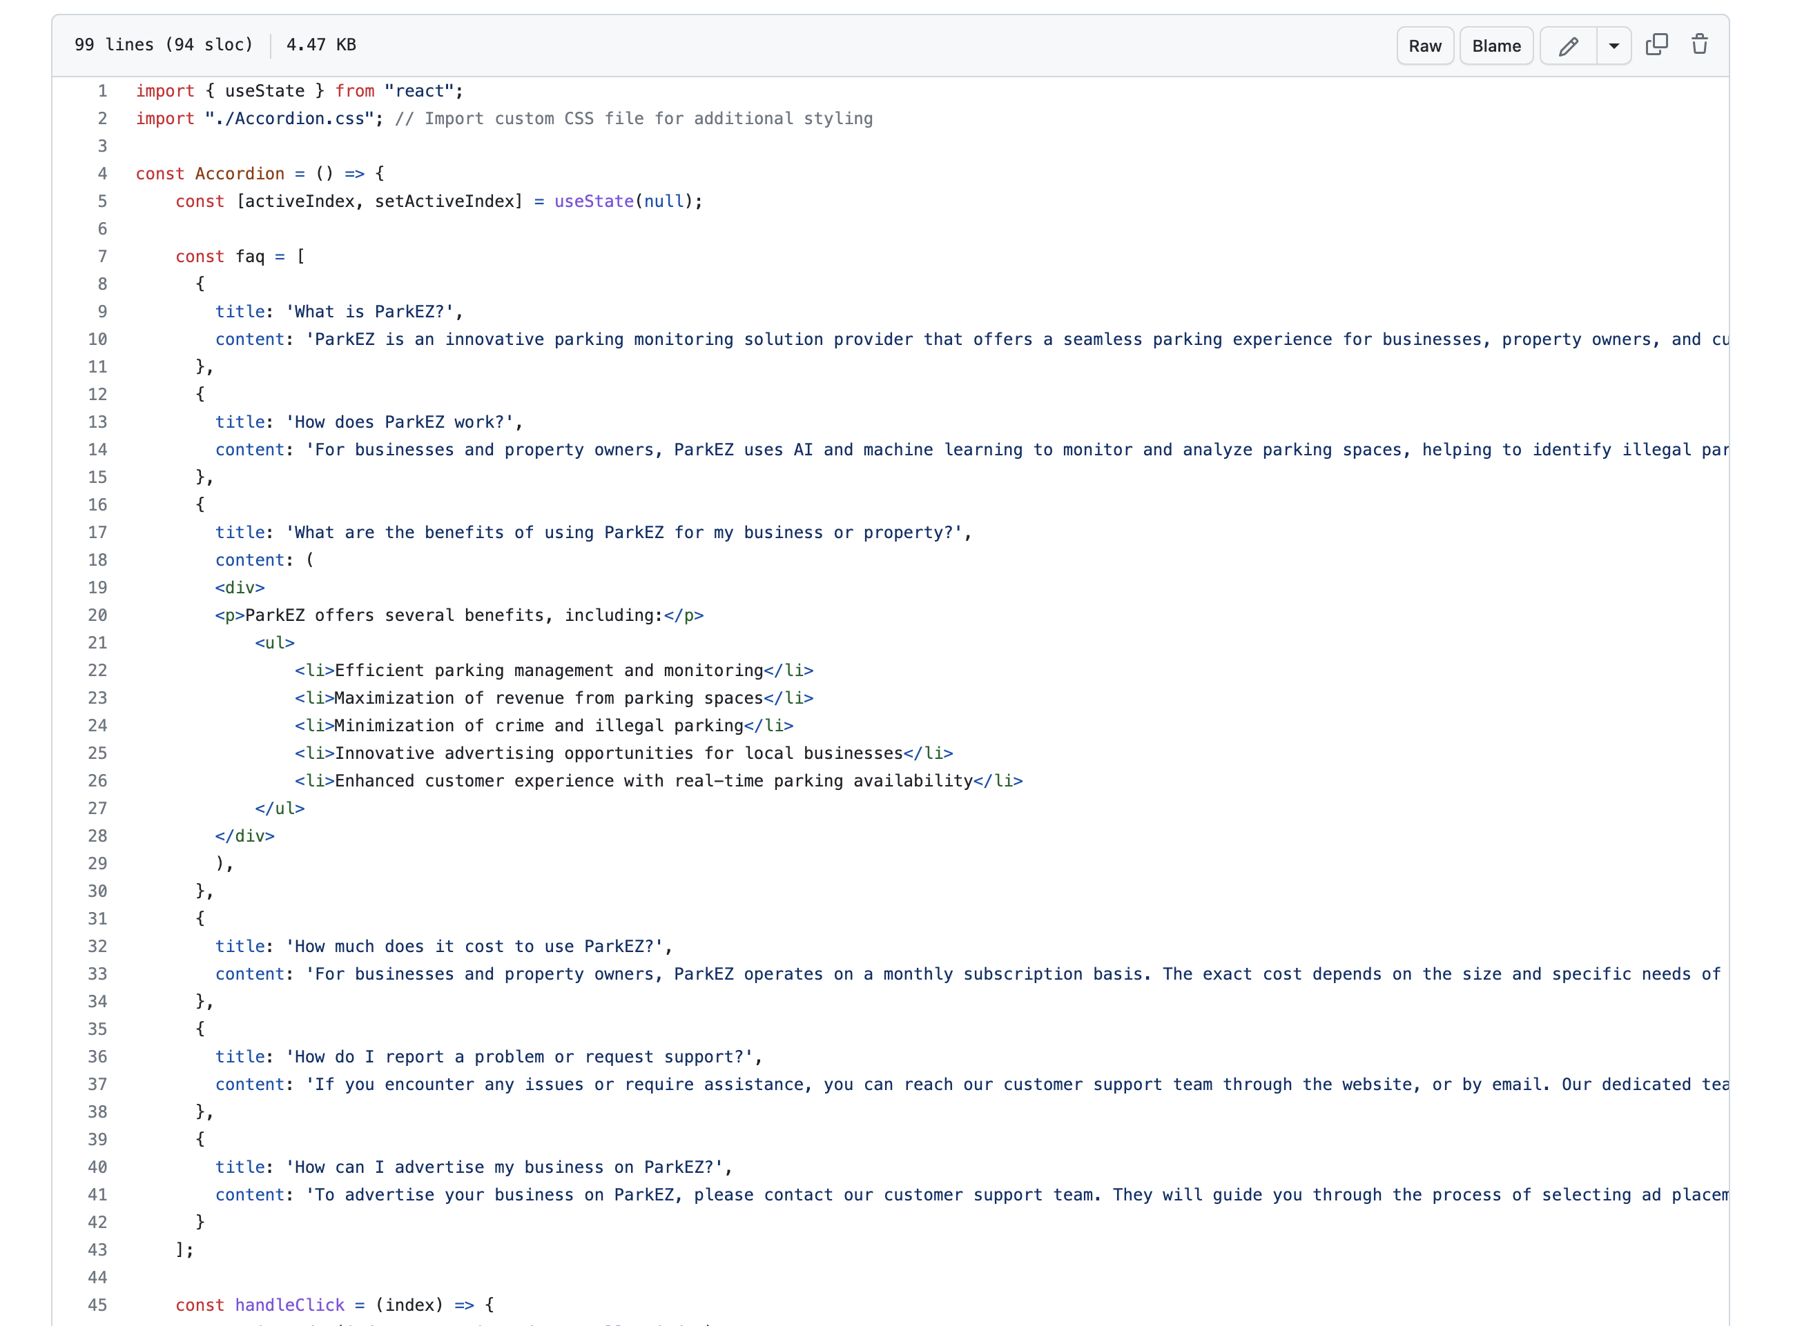
Feature- FAQ

Slide 20
Thank You!

